Slide 1
What I Learned from Gordon Tullock
Prof. Bryan Caplan
Dep’t of Economics and Mercatus Center
George Mason University

Slide 2
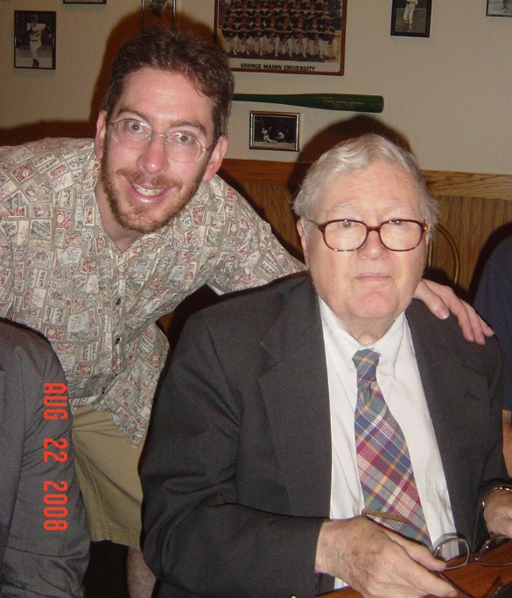
My Time With Tullock
I met Gordon Tullock in the summer of 1993, soon after reading The Calculus of Consent in college.
I joined the GMU econ faculty in 1997. Two years later, Gordon returned to GMU.
I regularly saw and lunched with Gordon until his retirement.
Still, it’s hard for me to separate the man from his ideas, because Tullock’s ideas infused his whole existence.
Highlights…

Slide 3
Political Man
Tullock wasn’t just one of the first social scientists to use economics to understand politics. He remains one of the most thoughtful.
Unlike Buchanan, Tullock didn’t see politics as “an exchange.” Instead, he saw self-interested actors playing a brutal game of “finders keepers.”
This is especially clear in Tullock’s work on dictatorship. Dictators aren’t just milking their subjects for all they’re worth. They’re also desperately trying to stay alive.
Yet Tullock was quick to acknowledge anomalies – and fit them into his broader framework.
The charity of the uncharitable.
The evolution of constitutional monarchy in 19th-century Europe.

Slide 4
Ultra-Cynicism
Tullock was proudly cynical. This let him see ugly truths most social scientists prefer to ignore.
The paradox of revolution: Contrary to almost every historical narrative, the mass of men are politically apathetic.
The nature of revolution: Winners overcome this silent apathy by any means necessary. This is never pretty at the time, and normally ends in disaster.
The good news: Political apathy spares mankind the horrors of “successful” revolution.

Slide 5
Iconoclasm
Tullock’s deepest lesson, though, is: Ask awkward questions.
Two random examples:
What’s so bad about dictatorship?
Give me one good reason not to invade Brazil.
Technically, many economists had the skills to do what Gordon did. But very few tried to compete with him.
Why? Because Gordon wasn’t afraid to offend.
Many people have told me that Gordon’s iconoclasm cost him a Nobel Prize. To me, this misses the real point: Gordon deserved a Nobel Prize because of his iconoclasm.

Slide 6
Gordon Tullock, 1922-2014

